Slide 1

MANAGEMENT OF NATURAL RESOURCES
Water Conservation

Slide 2


Slide 3
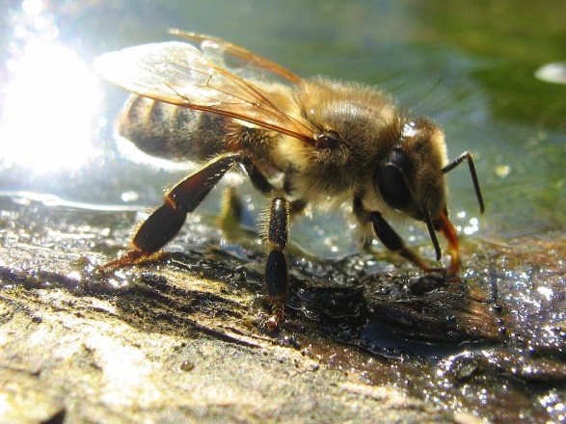

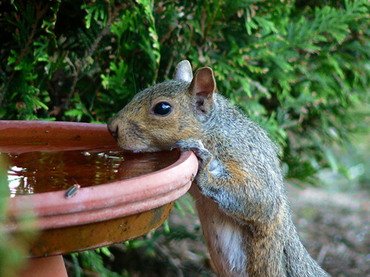

WATER FOR ALL
Water is a basic necessity for all terrestrial forms of life.

Slide 4

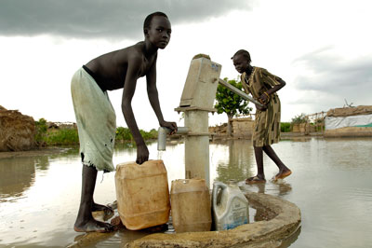
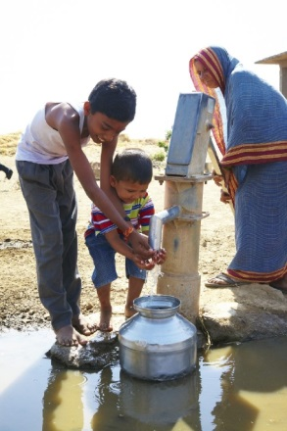
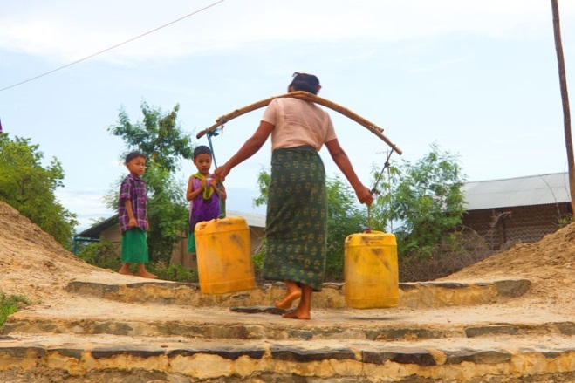

WATER FOR ALL
Water is a basic necessity for all terrestrial forms of life.

Slide 5
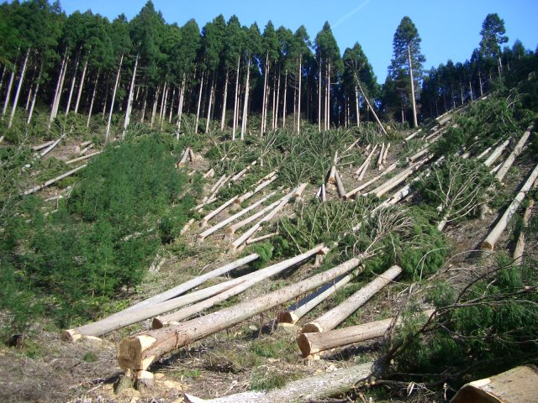
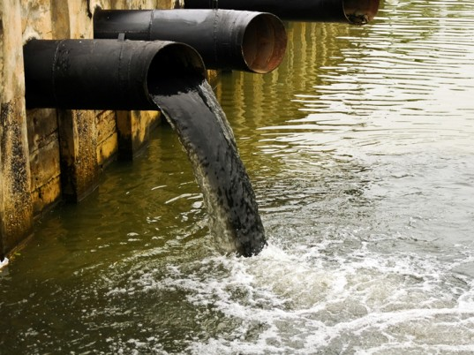

WATER FOR ALL
Human intervention also changes the availability of water in various regions.
Rains in India are largely due to the monsoons.
This means that most of the rain falls in a few months of the year.

Slide 6
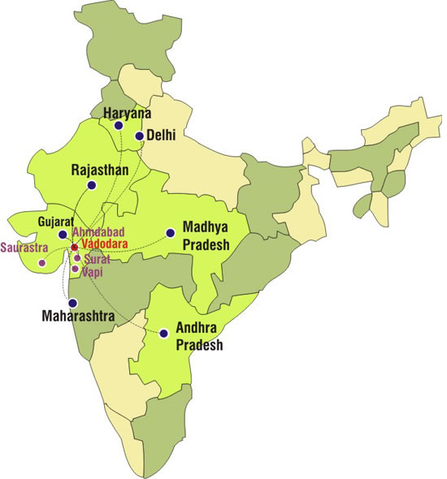
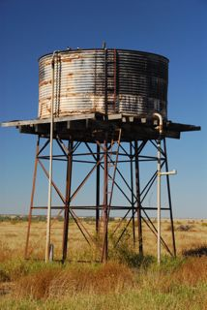
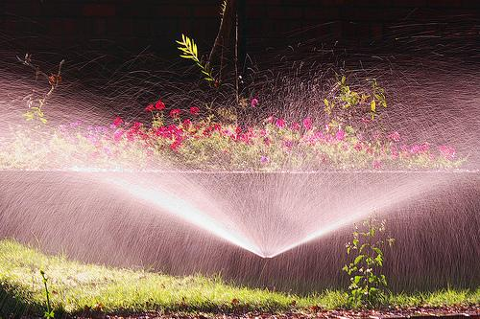
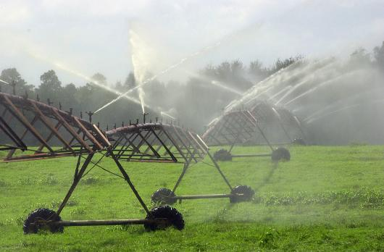
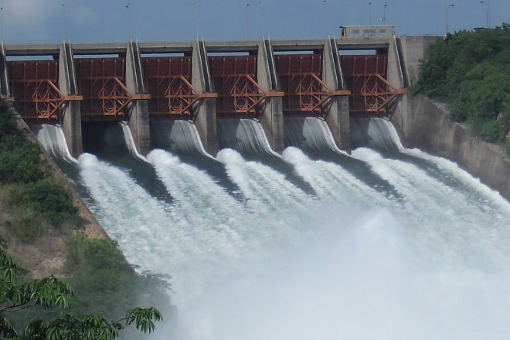

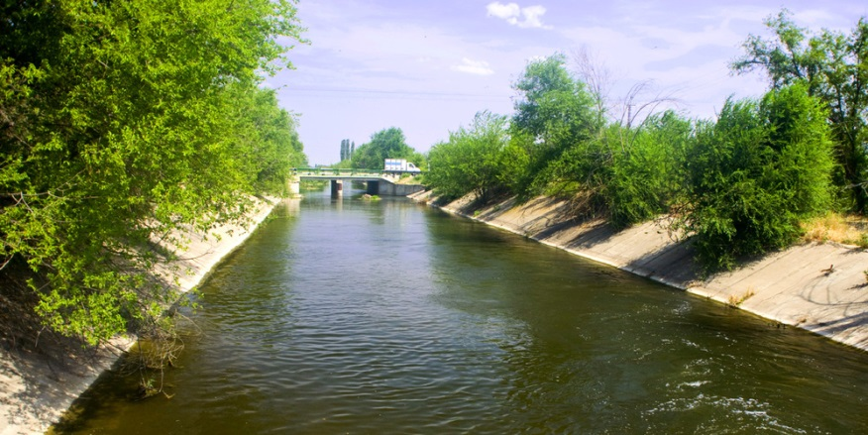
Irrigation methods like
dams, tanks and canals have been used in various parts of India since ancient times.
These were generally local interventions managed by local people and assured that the basic minimum requirements for both agriculture and daily needs were met throughout the year.

Slide 7
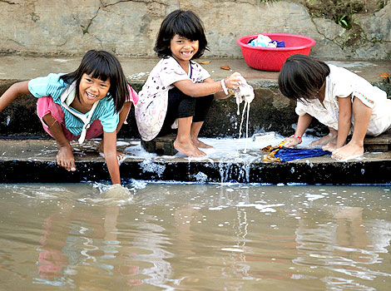
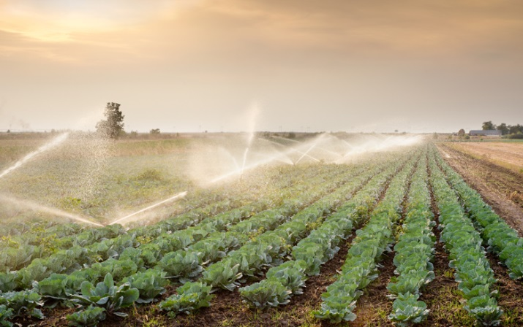
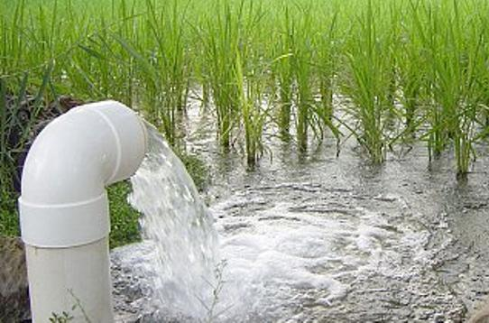
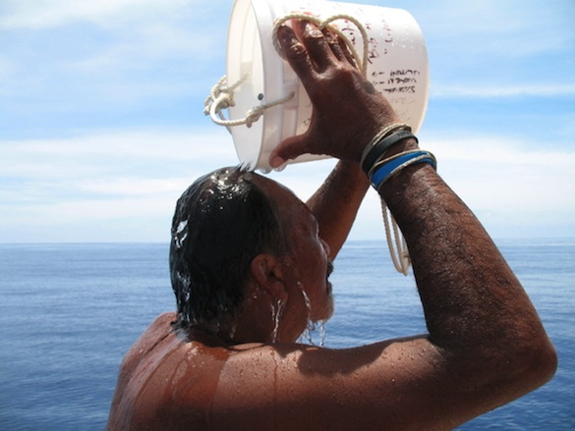
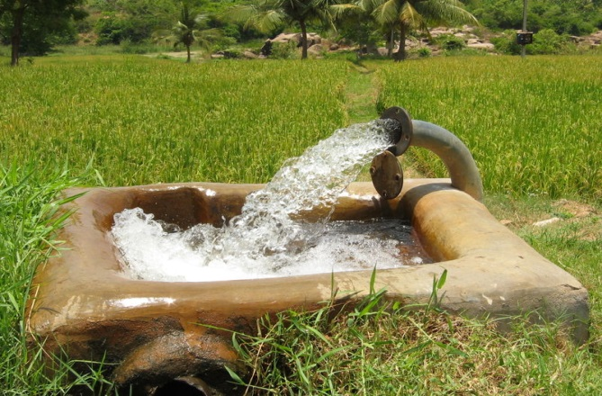

These were generally local interventions managed by local people and assured that the basic minimum requirements for both agriculture
and daily needs were met throughout the year.

Slide 8
Thank You

